Slide 1
AUBG Academic
Progress Tracker
Senior Project • Progress Presentation
C# • Blazor • SQLite • Entity Framework Core
Current focus: advanced GPA search algorithms
5-minute update
Notes:
Hello. This is a short progress presentation of my senior project, the AUBG Academic Progress Tracker. The project started as a simple GPA calculator, but it has developed into a full Blazor application with persistent storage, course and semester management, academic statistics, and now a much stronger algorithmic component.

Slide 2
1. Problem and Project Goal
From a console GPA calculator to a complete academic planning application
Track academic progress
Courses, semesters, grades, attempted credits and earned credits in one place.
Core objective
Turn raw course data into useful decisions.
Understand the current position
The application is a local single-user tracker. It does not replace official university systems; it helps the student organize information, test scenarios and plan ahead.
Cumulative GPA, semester GPA and completed-course statistics are calculated automatically.
Plan future outcomes
TRACK
CALCULATE
SIMULATE
OPTIMIZE
What-if simulation and the Target GPA Solver help evaluate future academic scenarios.
Notes:
The goal is not just to display grades. The application combines three ideas: tracking the academic record, calculating the student's current status, and planning future outcomes. It is designed as a local personal tool, so the main focus is software structure, reliable calculations, persistence, and algorithmic decision support.

Slide 3
2. System Architecture
A layered design separates UI, business logic, data access and storage
Presentation Layer
Blazor Razor components • Dashboard • Courses • Semesters • What-if • Target GPA
Service / Business Logic Layer
CourseService • SemesterService • GpaCalculator • CreditCalculator • WhatIf logic • TargetGpaSolver
Data Access Layer
AcademicDbContext • Entity Framework Core
Database Layer
SQLite local database
Notes:
The project uses a layered architecture. Razor components handle presentation. Services contain application rules and calculations. Entity Framework Core provides the data-access layer, and SQLite stores the persistent data locally. This separation is important because the more advanced GPA algorithms can be developed and tested independently from the user interface.

Slide 4
3. Data Model and Persistence
SQLite replaced the original in-memory list and now preserves the academic record
Semester
Course
1
one-to-many
N
PK Id
Code
Name
Credits
Grade
FK SemesterId
PK Id
Term
Year
Persistent storage
EF Core migrations
Clean repository
Courses and semesters remain available after restart.
Database structure is versioned and can be recreated.
Local SQLite data is excluded through .gitignore.
Notes:
The data model currently has two persistent entities. A semester can contain many courses, and each course belongs to one semester through SemesterId. SQLite replaced the original temporary list, so data now survives application restarts. Entity Framework Core migrations manage the schema, while the local database file itself is excluded from Git.

Slide 5
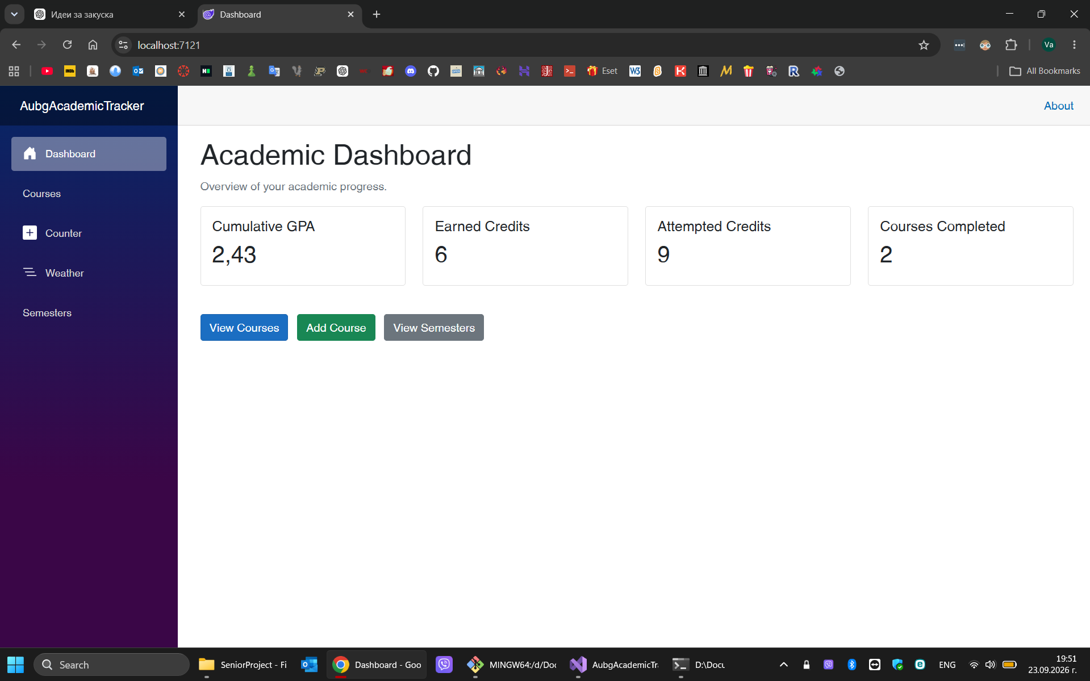
4. Features Implemented So Far
The project already supports the full core academic workflow
Course CRUD
Add, view, edit and delete courses
Semester management
One-to-many course relationship + semester GPA
Academic statistics
Cumulative GPA, earned / attempted credits
What-if calculator
Temporary future courses without changing stored data
Target GPA solver
Automatically recommends future grade combinations
Real dashboard screenshot
Notes:
At this point the application has the complete core workflow. Courses support full CRUD operations, semesters are stored as real entities, the dashboard shows cumulative GPA and credit statistics, and semester GPA is calculated from related courses. I also added two planning features: the manual What-if Calculator and the automatic Target GPA Solver.

Slide 6
5. What-if GPA Calculator
A safe simulation layer that never changes the real academic record
Stored academic record
Current courses and grades loaded from SQLite.
Projected GPA
Key design choice
Combine quality points + attempted credits
Hypothetical data stays in memory only. It is never saved to SQLite.
Hypothetical courses
Temporary name, credits and expected grade.
Useful engineering feature — but still based on weighted-average calculation.
Notes:
The What-if Calculator was the first planning feature. It combines the real academic record with temporary future courses and calculates a projected GPA, but the hypothetical courses are never saved. This was a useful design step, although algorithmically it still used the same weighted-average calculation as the dashboard. That led to the next feature.

Slide 7
6. Target GPA Solver
The inverse problem: the target is known, but the future grades are unknown
Current record
Existing quality points and attempted credits
TargetGpaSolver
Output
Searches grade combinations
and returns the easiest feasible solution
Recommended grade for each course
+
Projected final GPA
Target GPA
Example: 3.20 cumulative GPA
Remaining courses
Course names and credit values — no grades entered
This is a combinatorial search problem — not a single formula.
Notes:
The Target GPA Solver reverses the What-if problem. The user gives a target GPA and a list of remaining courses, but does not enter future grades. The program has to search for grades that can achieve the target. Because many combinations may be valid, this becomes a combinatorial search problem rather than a single weighted-average formula.

Slide 8
7. Algorithm 1 — Backtracking Search + Pruning
Recursive search explores grade combinations; pruning cuts branches that cannot help
Course 1
Backtracking
Try a grade → recurse to the next course → undo the choice → try another grade.
Complexity
Worst case
O(gⁿ)
Best-case pruning
A
B+
B
g = possible grades
n = remaining courses
If even all remaining grades = A cannot reach the target, stop the branch immediately.
Measured in the app
PRUNED
Lowest-grade pruning
• Search nodes visited
• Branches pruned
If all remaining grades = D already satisfy the target, higher-grade alternatives are unnecessary.
Notes:
The first major algorithm is recursive backtracking. Every level represents a remaining course and every branch represents a possible grade. In the worst case this grows exponentially, O of g to the n. To reduce the search, I added pruning. Impossible branches are cut when even all A grades cannot reach the target, and easy branches finish early when all D grades are already enough.

Slide 9
8. Algorithm 2 — Dynamic Programming via Memoization
The solver became much faster by reusing repeated subproblems
Different paths can reach the same state:
Combination A
Earlier grade choices
(courseIndex, pointsNeeded)
Dictionary cache
Same remaining subproblem
Solve once
Reuse later
Combination B
Different earlier choices
Integer-scaled states
Pseudo-polynomial behavior
Measured reuse
3.7 → 37 and 3.3 → 33 avoids floating-point key inconsistencies.
Approx. O(n × P × g) over distinct memoized states.
The UI reports memo hits: repeated states solved from cache.
Notes:
Pruning helped, but large reachable searches were still slow because different grade combinations could lead to the same remaining problem. The second algorithmic approach is dynamic programming through memoization. A state is defined by the current course index and the points still needed. Once a state is solved, its result is cached and reused. This produced the major performance improvement in the solver.

Slide 10
9. Current Status and Next Steps
The core application works; the remaining work focuses on the third algorithm, testing and polish
✓
✓
✓
✓
Core app
Academic logic
Planning
Algorithms
Next
CRUD + SQLite
GPA + credits
What-if + solver
Backtracking + DP
Graph planner + tests
What is already strong
Next milestone
Persistent application + complete course workflow + two non-trivial algorithmic approaches.
Stage 9: Degree Progress + prerequisite graph + topological sort, followed by unit tests and final polish.
Takeaway: the project has evolved from a calculator into a structured academic planning system with measurable algorithmic behavior.
Notes:
The core application is now working and the algorithmic direction is much stronger. Two substantial approaches are implemented: backtracking with pruning, and dynamic programming through memoization. The next major stage will add the third distinct algorithm through a prerequisite graph and topological sort, followed by unit testing, error handling, and final UI and thesis polish.

